Slide 2
Mental Health and Psychosocial Care
ideas currently being developed in ITm
Partly based on the experience of HealthNet-TPO

Slide 3
Previous experience in Mental Health and Psychosocial Services (MHPSS) - since 1992, projects in emergency relief and/or integrating psychiatry in 33 countries
Afghanistan | DR Congo | Indonesia | Nicaraqua | Rwanda
Algeria | Djibouti | Kenya | Oost-Timor | Sri Lanka
Angola | Ethiopia | Kosovo | Pakistan | South Sudan
Bosnia | Eritrea | Lesotho | Palestine | Suriname
Burundi | Georgia | Mozambique | Peru | Iraq
Cambodja | Haïti | Netherlands | Rumania
Costa Rica | Honduras | Namibia | Uganda

Slide 4
Most important lessons learned:
Integrating psychiatry in a low-income health system has not lead to sustainable quality services
Providing relevant support in terms of cultural differences remains a challenge
It is helpful to clearly separate (basic) psychiatry from psychosocial support, and divide tasks over different sectors.
Legitimacy and Accountability
Required support (salaried staff, training, drugs, governance) was never extended beyond project funding.
Sectoral Challenges

Slide 5
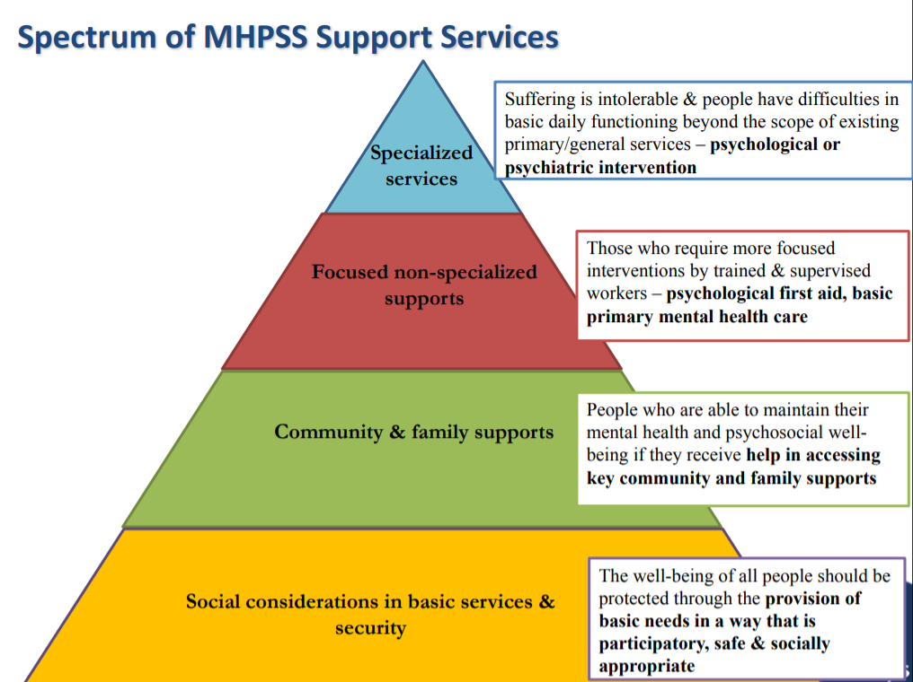
The current ‘paradigm’
The pyramid was designed by the IASC working group (2010).
The challenge was to bring some coordination and logic in a myriad of interventions that came up after ‘psychosocial’ was ‘discovered in early 1990s.
The perspective remains focused on
services to address ‘illness’

Slide 6
An alternative look on MHPSS programming
The ‘mental health’ condition of individuals and the community is still mostly ignored in aid and development programmes.
At the community level, local action and change is more important than introducing new services.
To understand the MHPSS field, we propose 3 different angles, ranging from humanitarian relief to social work.
Legitimacy and Accountability
Integration of mental health services
MHPSS in crisis
Adding mental health perspective in relevant areas.
Sectoral Challenges

Slide 7
1. Integrate Mental Health in Health System
2. MHPSS in crisis
3. MHPSS aspects across sectors

Slide 8
1. Integrate Mental Health in Health System
Building up sustainable services requires the right resources, connection with the population, and institutional support
Legitimacy and Accountability
Health Systems approach
Local ‘report’ to be relevant and effective
Resulting in sustainable quality services
Sectoral Challenges

Slide 9
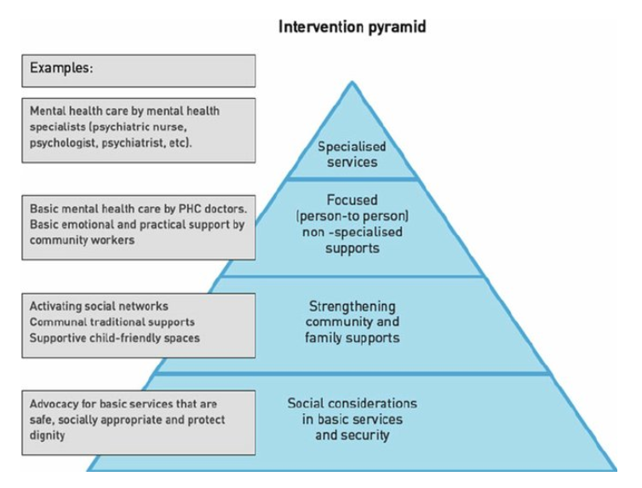
2. MHPSS in crisis
Sectoral Challenges

Slide 10
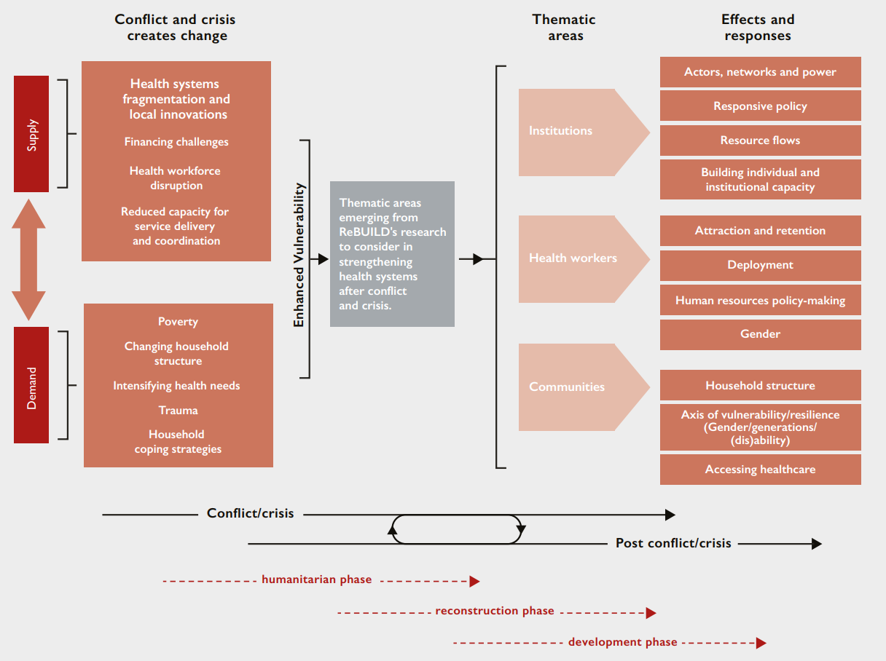
Thematic areas emerging from ReBUILD's research on health systems in post-conflict settings
3. MH and psychosocial aspects across sectors
NCDs and chronic conditions
Social breakdown
SRHR
Collective trauma
Relate to other sectors

Slide 11
MH and psychosocial aspects across sectors
(examples)
TB, Aids, Cancer
Fear, exclusion
GBV, FGM
Transgenerational, lack of trust
Education, economy, religion

Slide 12
Anchored in health system
Area of work
RMM
Psychiatry & Psychology
Clinical MH integration health system
Psychosocial outreach (social psychiatry)
Social Work
Consequences violence, war, disaster
Social determinants of well-being
referral
Anchored in economic, social, educational, communal system
Notes:
This is the range of interventions we have designed:
The upper part are interventions in the health sector, where we adhere to principles of public health and social psychiatry. Outreach into communities and psycho-education are part of interventions here. We are sometimes part of the overall health sector, and we are fully aware that here we are seen as such. In other words, the medicalization of the effects of war and violence needs to be controlled.

Slide 13
Examples of interventions
MH Gap, Basic Psychiatry
Anchored in health system
Area of work
RMM
Psychiatry & Psychology
Clinical MH integration health system
Psychosocial outreach (social psychiatry)
Social Work
Consequences violence, war, disaster
Social determinants of well-being
PHC coverage, referral, follow-up, group therapy
referral
Group- and sociotherapy, CTP, (collective trauma)
Behaviour change
Anchored in economic, social, educational, communal system
Notes:
Below the line are community interventions. These aim to address the consequences of warfare and conflict in the community, and to address socio-economic determinants of well being – or a state of total wellbeing as the WHO defines health.

Slide 14
Community versus ‘Health’ interventions
Integrated in the formal health sector
Integrated in health system (salaries, staff, drugs, etc)
Epilepsy/
psychosis medication
Psycho-education for caretakers
MH in primary care
SETTING
FOCUS
Individual counselling
People with distress
People with disorders
Everybody
Life skills
Socio therapy
Support groups
Rehabilitation after schizophrenia/
psychosis
Collaboration with/referral to NGOs and other resources
Awarenes
raising/ Psycho-education
Advocacy
Implemented in the community
Notes:
Mounting evidence suggests that the impact on mental health of war is not inevitable, but rather intimately related to the social, economic and cultural conditions that precede and follow violent conflict.^{5,38,39,41}
The goal is to increase attention to the equally damaging forces of chronic injustice in the form of ongoing financial, social and health-related threats that erode everyday mental health.
Moreover, pre-conflict marginalisation may increase vulnerability to exploitation by militant groups. Maoists used the promise of eradicating social inequities to recruit adults and children into their military.^{14,42}
This leads to a final important observation of this study: psychiatric morbidity did notdecrease for any demographic group. This challenges suggestions, such as those proffered by militant revolutionary movements, that violent uprising is a form of psychological emancipation. Ultimately, addressing risk factors for poor mental health such as poverty, lack of education, inadequate healthcare and gender- and ethnic/caste-based discrimination, in addition to trauma healing, may not only ameliorate mental health problems, but also help to reduce vulnerability to exploitation and involvement in political violence.

Slide 15
Thank you for your attention!
Willem van de Put
+31622908419
wvandeput@itg.be

