Slide 1
Complex Urban Governance in New Delhi Slums
Be-cause Health Annual Conference: Taking the Urban Turn
Presented by Deepika Saluja
Supported by Institute of Tropical Medicine, Antwerp (Sara Van Belle & Bruno Marchal)
& National Health Systems Resource Centre, Delhi (Rajani Ved)
Notes:
Good afternoon everyone. Thank you for coming for our session. I am going to talk today about the pilot project that we are carrying out in Delhi to understand the urban governance and its complicated nature. We hoped that we will be able to do a few interviews and present the preliminary findings here, but due to some administrative delays and approvals, the interviews could not be conducted by now, and so I will be presenting briefly the context and pre-data collection work.

Slide 2
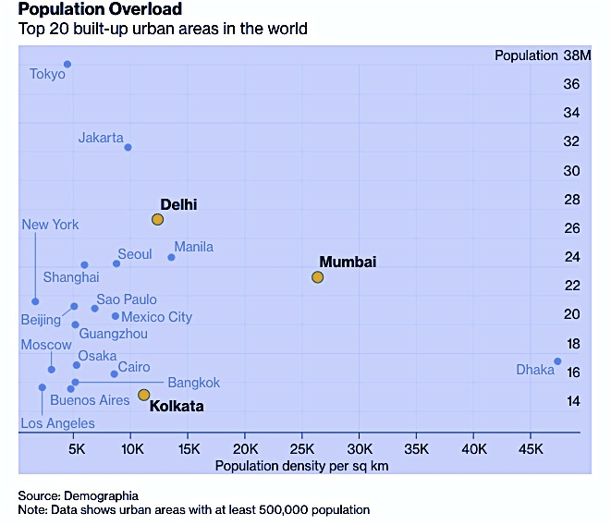
Urbanization and its characteristics: India (New Delhi)
- Population Growth
Urban population in India 31% (2011) → 46% (2030)
30-40% of metro city population lives in slums
Delhi – home to 29 million with ~700,000 joining them each year
By 2028, Delhi’s population likely to outstrip Tokyo (UN Estimates)
- Migration to Urban areas
Better opportunities vs. exposure to new threats
- Pressure on the Government and the existing infrastructure
- Growing income inequality
- Chronic shortage of housing
Kumar et al. 2018; Lama-Rewal, 2011
Notes:
The phenomenon of urbanization has been highlighted in the morning presentations in African countries As has been highlighted in the presentations earlier this morning, phenomenon of urbanization is

Slide 3
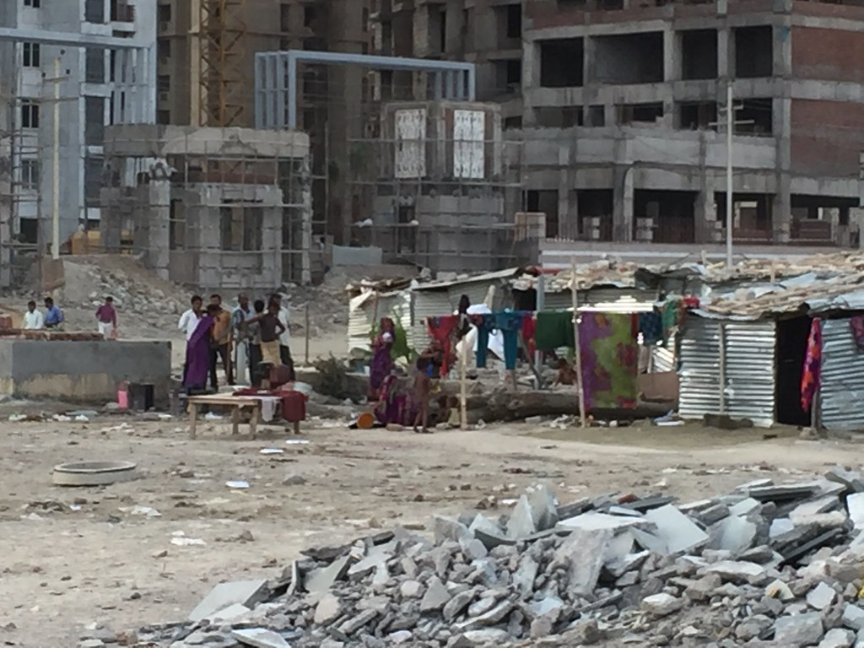
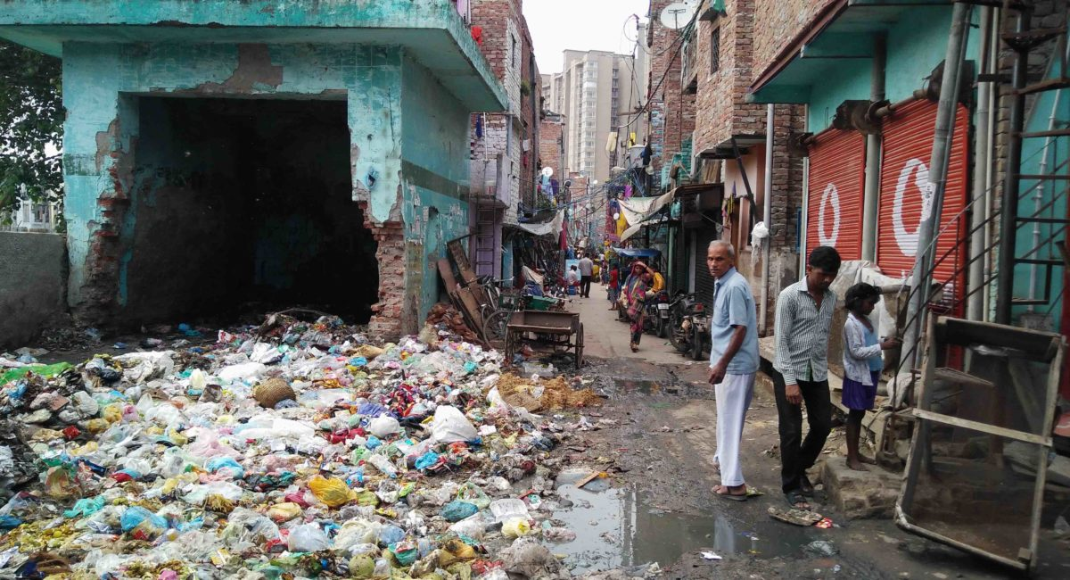
Migration and Slum inhabitations
- Influx of population into slum and shanty habitations (largely informal sector)
- Environmentally deprived urban areas
Generally overcrowded
With no access to safe water and sanitation
Unhealthy and unhygienic living conditions
Lack access to basic services – health, education?
Image 1: https://kib.org.in/news/life-in-a-slum-ugly-face-of-india/
Image 2: Migrants displaced by flooding in Uttarakhand live in unhygienic shanties upon arriving in Delhi. Credit: Neeta Lal/IPS Flicker.com

Slide 4
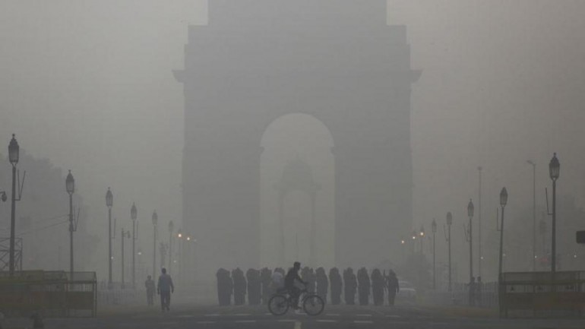
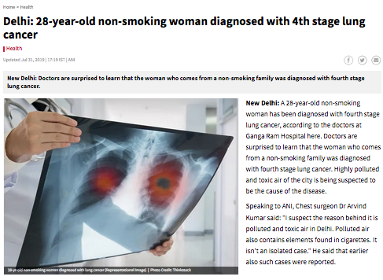
Air Pollution: An emergency?
The AQI remained above 200 in several parts of Delhi and adjoining areas on Sunday Oct 14, 2019 Source: Reuters
Notes:
Other Environmental concerns

Slide 5
Multiple disease threats and other problems
- Increasing NCD burden: 24% of slum dwellers suffer from diabetes in Kolkata(WDF, 2016)
- Seasonal outbreaks: potential of turning into an epidemic in densely populated areas
Vector-borne and water-borne diseases: malaria, chikungunya, dengue etc.
- Increasing no. of road accidents: 17 deaths and 55 road accidents/hour
- Violence, crime, drug and alcohol abuse
Lack of sanitation infrastructure - gender based violence (Chaplin & Kalita, 2017)
Cases of abuse and crime amongst young boys in slums: lack of education and employment (Bhattacharya, 2012)

Slide 6
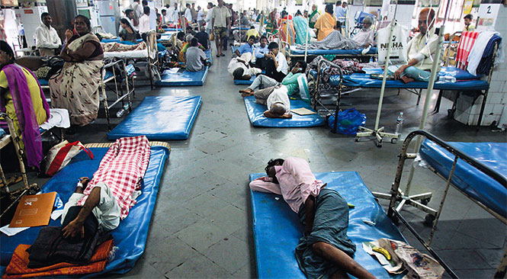
Inadequate Public Health Infrastructure
- Increased burden on public (health) infrastructure - lack of facilities, doctors, medicines etc.
- Large no. of secondary and tertiary care hospitals
But lack of primary health infrastructure
Pushes people towards hospitals - for their most basic health problems – overburdens the public hospitals

Slide 7
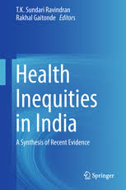
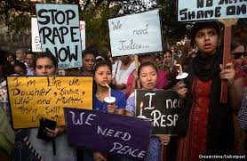
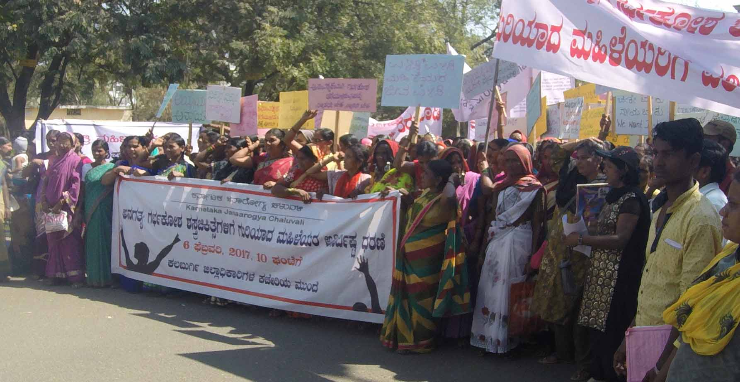
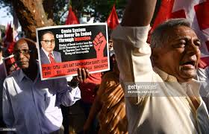
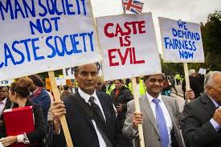
Health Inequities & Governance Failure
- Health threats in slums: further compounded by social exclusion, stigma and social injustice most vulnerable: for eg. migrant Dalit single-women households
- Policies aggravating inequities: from slum clearance and eviction to slum upgrading
Smart Cities Mission, Slum-free Policy
Recognition of slums as vibrant places, corollary to formal economy
Need to involve slum dwellers, community-based organisations & local authorities in bottom-up local governance solutions
Local (informal) governance practices

Slide 8
Public Health Care Organization in Delhi
Central Government
(MoHFW, AIIMS, ICMR, CGHS etc.)
Hospitals, dispensaries, polyclinics, welfare centres…
Elected Representatives
National Capital Territory of Delhi
(Dept. of Social Welfare, Health and Family Welfare)
Municipal Corporation of Delhi
(Health Dept., slum & Jhuggi Jhonpari wing, ESIS)

Slide 9
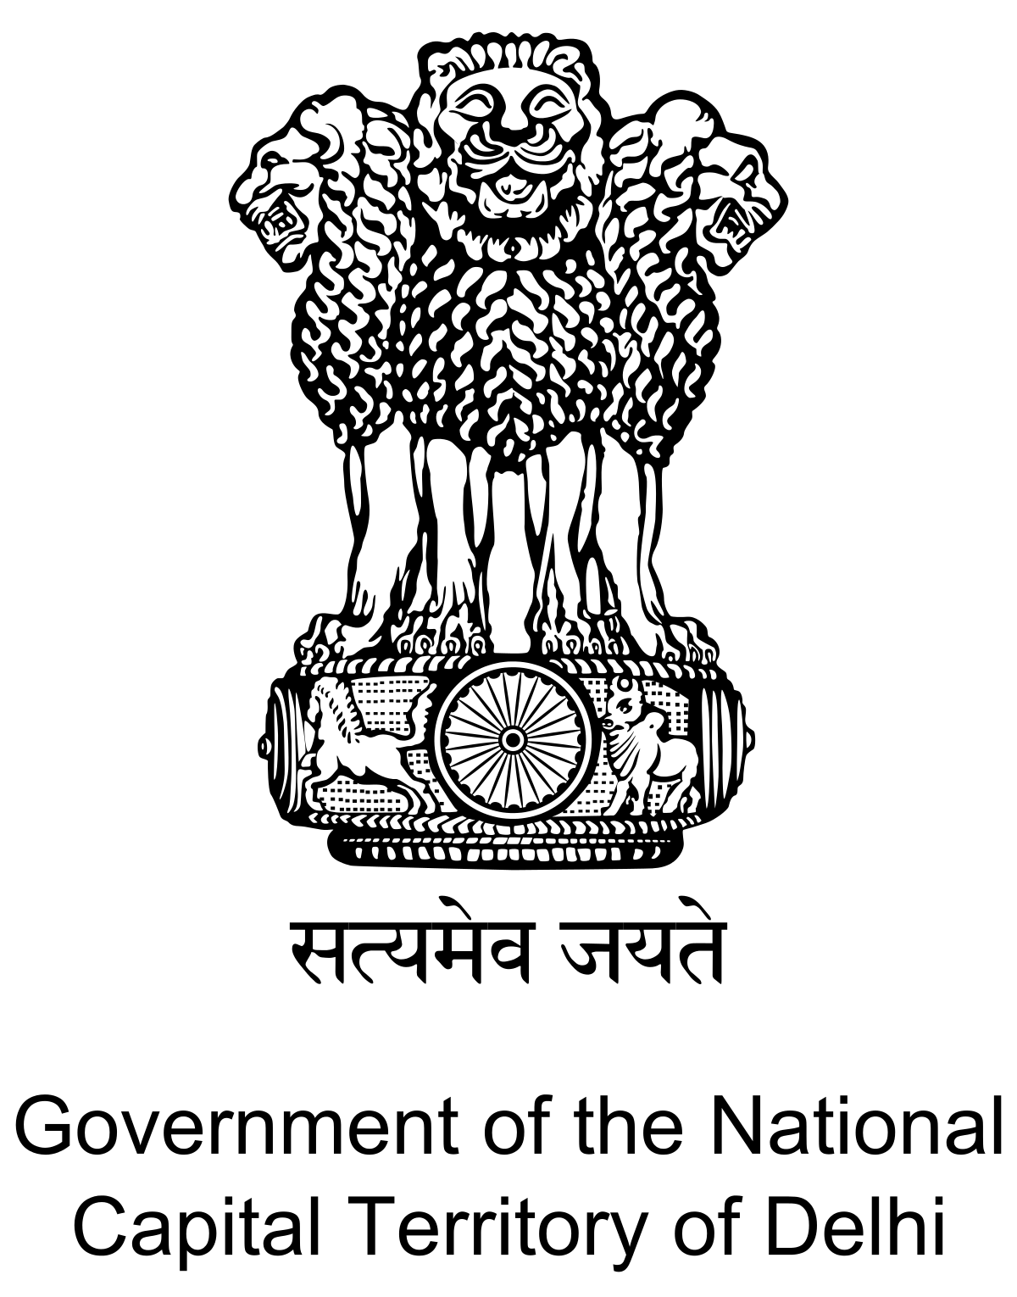
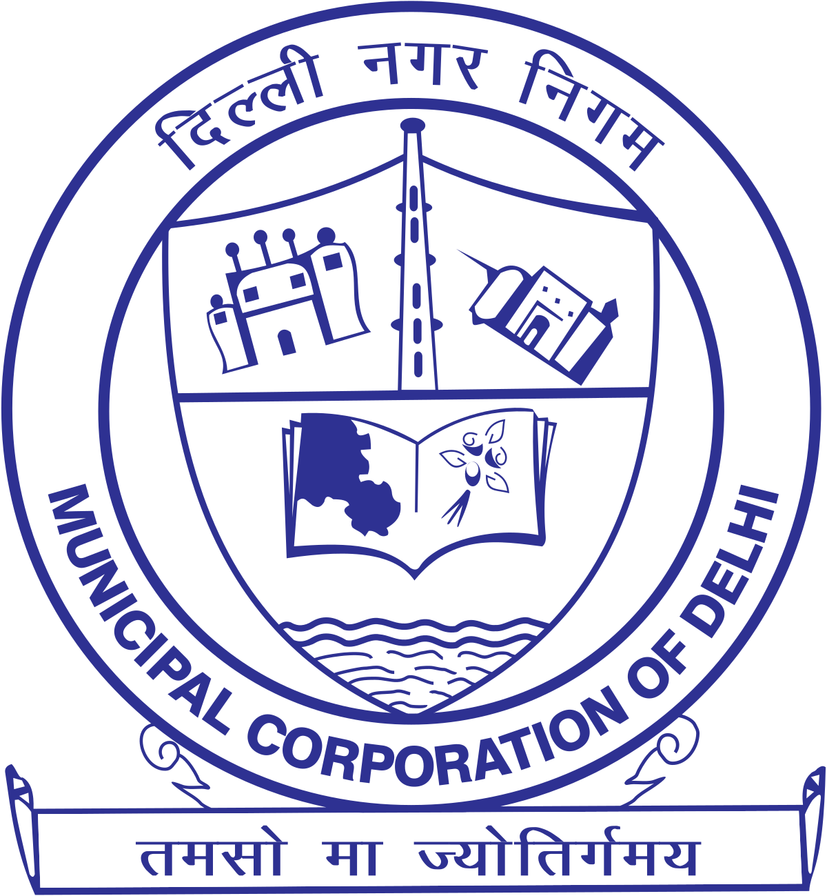
Complex Governance
- Multiple hierarchies
within the State Department, Municipal Corporation and the Elected Representatives
Additional departments and board to co-ordinate with (for eg. water, electricity)
- Additional horizontal and diagonal relationships amongst the responsible authorities
- Ambiguous roles and responsibilities, overlapping and duplicate mandates
- Complicated political economy (with multiple governments)
- Unregulated private sector – considerable part of health care delivery
- Unregistered slums – remain out of the purview of the governments
Difficult tracking households, services delivered and reporting on health indicators
Policy makers and administrations at a distance from slum realities
Bovens et al. (2014); Koppell (2005); Saluja (2018)

Slide 10
National Urban Health Mission (NUHM)
- Launched in 2013 as a sub-mission to National Health Mission
- leveraging on the structures created under National Rural Health Mission
“NUHM aims to improve the health status of the urban population in general, but particularly of the poor and other disadvantaged sections, by facilitating equitable access to quality healthcare through a revamped public health system, partnerships, community based mechanism with the active involvement of the urban local bodies”
(NUHM Framework for implementation, 2013)

Slide 11
Urban Healthcare Delivery Model

Slide 12
Thrust areas under NUHM for states

Slide 13
Methodology
Research Objective: To understand the governance mechanisms in the policy design and implementation of NUHM
Methodology:
A pilot formative exploratory study to understand the ICAMO configuration (Marchal et al. 2019)
Designing initial programme theory: to test later as part of the Realist Evaluation
In 2 urban slums of Delhi: one in North Delhi and one in South Delhi
Through in-depth interviews, observations and focus group discussions with key stakeholders implementing urban health policies in Delhi

Slide 14
Key Stakeholders
Stakeholders implementing the NUHM programme in 2 selected slum sites:
- Medical Representatives from U-PHCs, Dispensaries, Polyclinics, Welfare Centres etc.
Medical Health Officers, Public Health Managers, Community Health Workers
- Elected Representatives: Ward Councillors, Ward Health Supervisors, Mayor
- Deputy Municipal Commissioner and Municipal Commissioner
- State and National level Officials – Mission Director (NHM), Joint Secretary (MoHFW)
- NGO representatives and other private providers working in the region

Slide 15
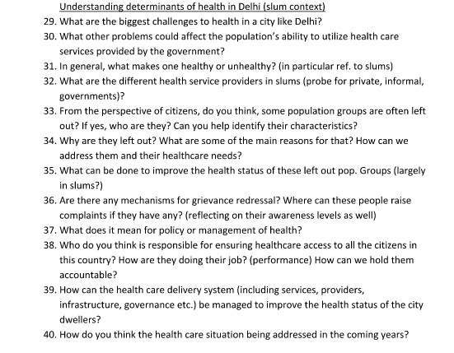
Glimpse of Interview Guide

Slide 16
Thank you!
Email-id: deepikas@iima.ac.in

