Slide 1
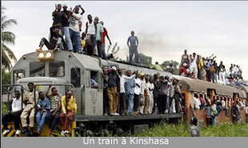
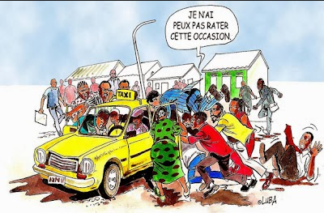
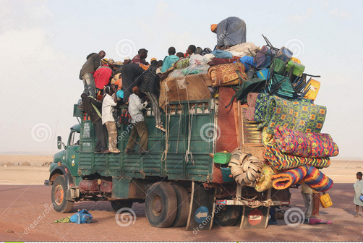
THE ROLE OF DISTRICT HEALTH MANAGEMENT TEAMS IN URBAN STEWARDSHIP, IN LUBUMBASHI, DR CONGO Chuy KD, Criel B, Van Belle S, Berlhiti Z, Mwembo TA and Chenge MF. Brussels, 16 October 2019
UNILU

Slide 2
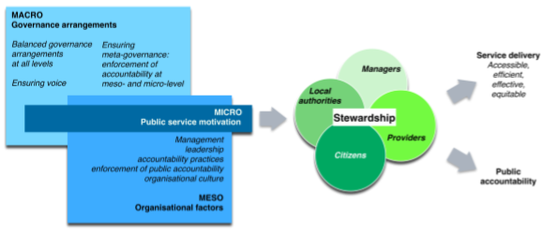
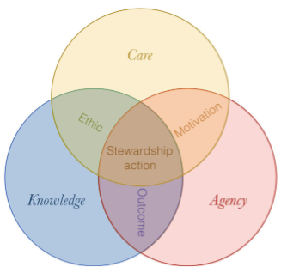
STEWARDSHIP, WHAT ABOUT IT ?
Stewardship/governance ?
WHO concept in 2000.
Careful + responsible management of
population’s well‐being
Importance
Piloting function of HS,
To build cost-effectiveness, Intersectoral HS, performance and SDGs attainment.
Vignettes
Accountability / responsibility
Normative / regulatory; Leadership / governance
(Gilson et al, 2012, Marchal et al, 2014)
(Enqvist et al, 2018)
Who ensure it ?
Health Ministry, Intermediate level managers, District Health Management Teams (DHMT)
Several models and typologies
Adaptative, Reformist, Sustainability, Transformist

Slide 3
Stewardship in cities
Global trends
2007= 5/10 people, 2030= 6/10 people ➔ especially in LMIC
Rapid urban growth
Natural growth, migration, reclassification = > Poor
Effects
Urbanization = health determinant
Rapid unplanned urbanization ➔ health + safety of poor
Challenges in urban health
(WHO, 1997, Roué-Le-Gall, 2018; Salem, 2018)
Taking the ‘city’ as an entry point
Taking the ‘health’ as an entry point
Healthy cities
(Barton et al, 2000, Roué-Le-Gall, 2018)
Lifestyles
(Gadais et al, 2017; Deluga et al, 2019)
Ecological approach
(Verbeek, 2014; Krefis et al, 2018)
Urban setting as determinant (ICSU, 2011)
Stewardship
Dialogue, integration, regulation
(Adapted from WHO, 1991, 1995, 2015)
Urban health (Glouberman, 2006)
Why urban matters (WHO, 2010)
Urban health problems (Rajan, 2016)
Health in City: complexity (Glouberman, 2006; WHO, 2009; Salem, 2018; Elsey et al, 2016, 2019)

Slide 4
FOCUS
Country context
HS Country Stewardship
Global Environment
Intermediate HS level
DHMT Stewardship
Health situation
Actors, other sectors
Norms and regulation
Health resources
Community Environment
Service delivery
Well-being
Adapted from Van Der Veken et al, 2014

Slide 5
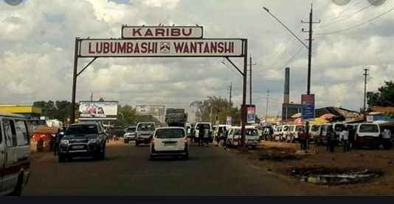
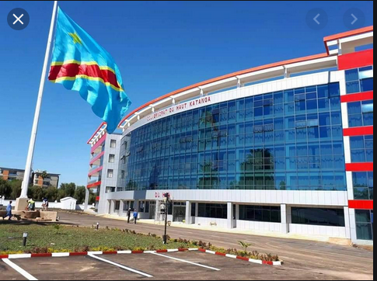
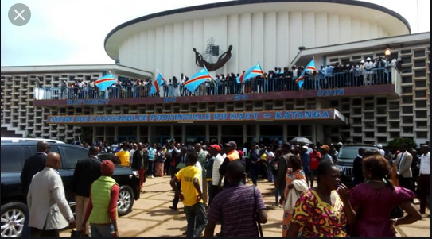
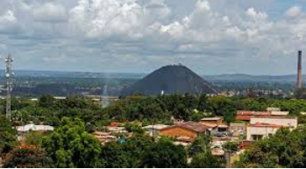
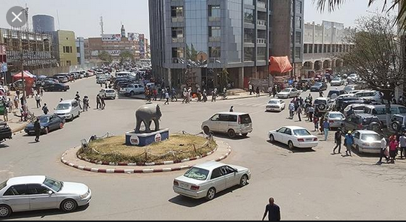
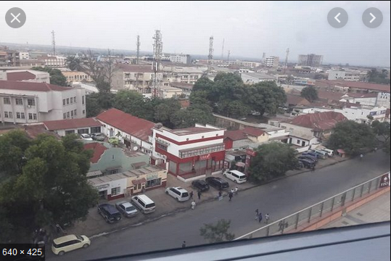
LUBUMBASHI
‘Entrée de la ville’
‘Gouvernorat de province’
‘Bâtiment du 30 Juin’
‘Gécamines et sa périphérie’
‘Centre ville’
‘Quartier industriel’

Slide 6
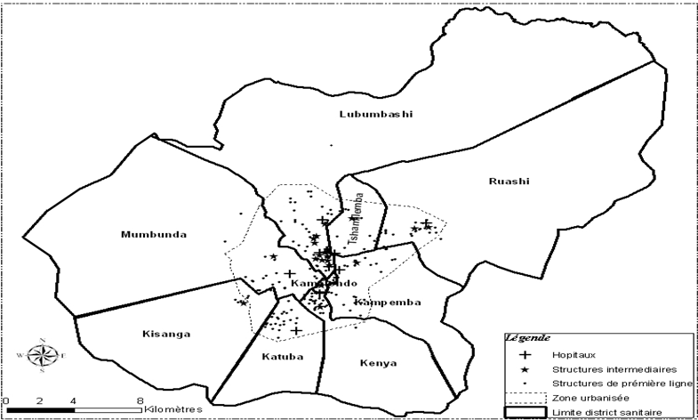
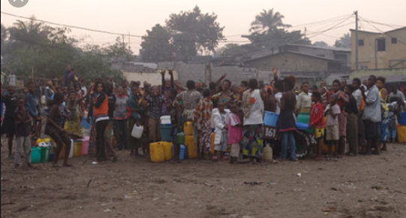
Local context
Lubumbashi, Haut-Katanga
747 Km² ➔ 140 Km² urbanised
2 500 000 inhabitants
9 Districts and DHMT
Intermediate HS level
Provincial Division
Provincial Inspection
Provincial Ministry of Health
Avoir de l’eau
(Chenge, 2013)

Slide 7
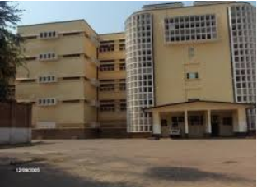
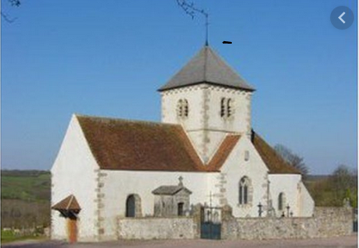
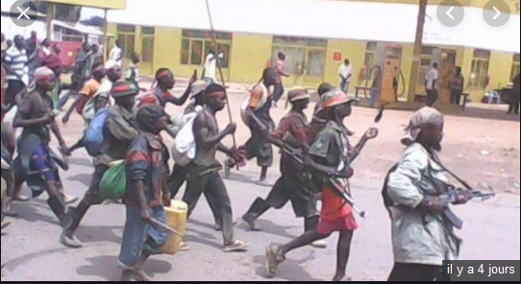
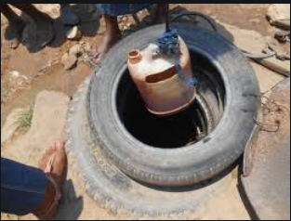
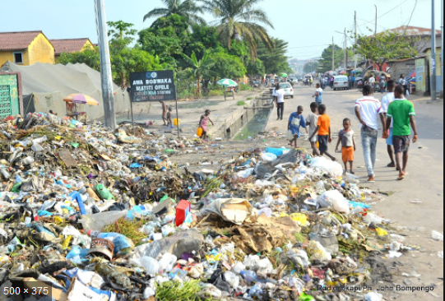
Contextual health challenges
Health
Horizontal growth:
inefficiency of urban services (health services,
infrastructures, equipment, facilities).
Burden of disease
Infectious diseases (waterborne)
NCD : heart, obesity, cancer hypertension, diabetes,
Mental health, accidents, injuries
Patients capturing in church, …
Poor living conditions
Safe water supply
Sanitation, waste disposal
Electricity, Crime and violence
Roads and public infrastructure
Food supply and unhealthy diets
Harmful tobacco and alcool use
Physical inactivity
Going beyond a sectoral approach
Poverty, Ecological challenges (Mines, Pollution,…).

Slide 8
HEALTH STEWARDSHIP IN LUBUMBASHI
Regulation = key lever and means by which a government can influence the quantity, quality, safety and distribution of health services and operationalize its health policy (WHO, 2016)
Objective: Identify challenges and levers for improving stewardship of DHMT in Lubumbashi
Healthcare organization
Healthcare regulation
Healthcare safety culture
Healthcare
norms
Chatelin et al, 2004; Gorgên et al, 2012; Besnard et al, 2017; Strauss, 2006; Raynaud, 1991.

Slide 9
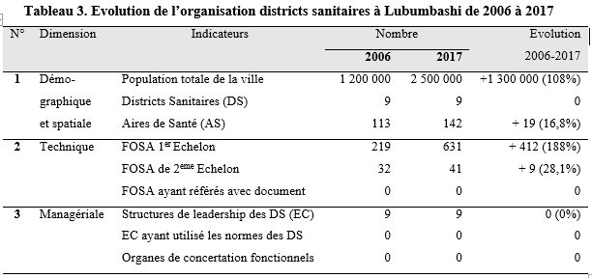
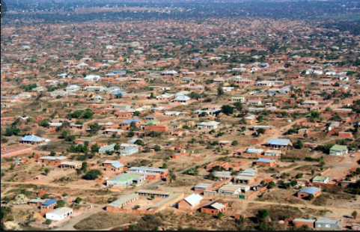
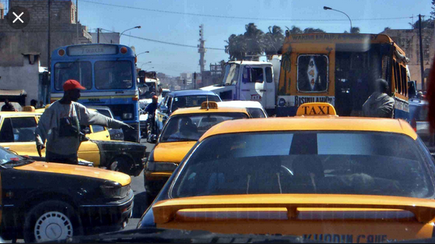
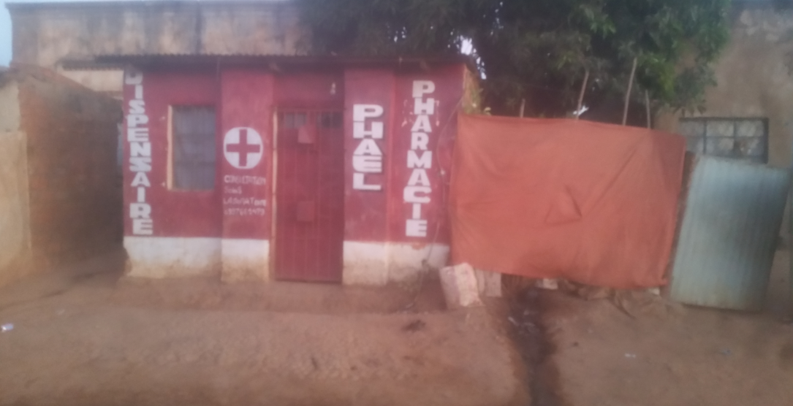
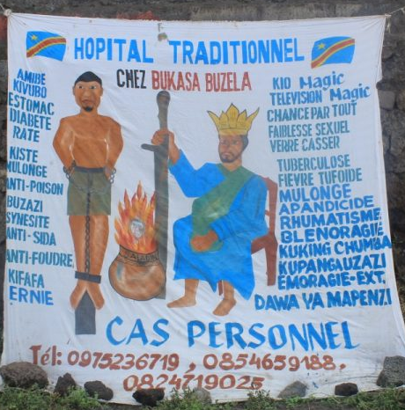
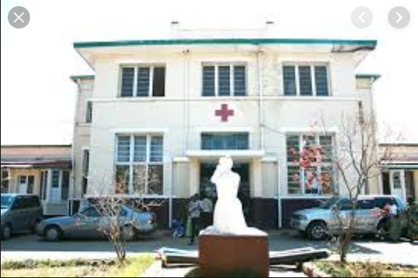
Challenges of the organization of health services

Slide 10
Regulation
«Les agents et services de santé font n’importe quoi à la population. Les autorités sanitaires ne savent comment et quoi contrôler, nous disant que ces formations sanitaires ont des parapluies» (STEW Leader com. 02).
Safety culture
« Ce centre médical a été saccagé après un décès maternel peropératoire pour une césarienne clandestine faite dans la salle d’accouchement, sans lumière, …. Le pire est arrivé… L’équipe opératoire a fui » (STEW – Observation FOSA 05).
Challenges of regulation, norms, and safety culture
of health services organization
Regulation (continued)
« Certains d’entre eux appartiennent à des autorités politiques et fonctionnent avec beaucoup d’irrégularités en tant qu’intouchables. Il n’y a ni code, mesure ni procédure définie pour réguler les services de santé. C’est le chacun pour soi… »
(STEW EC 09).
Norms
« Nous n’avons jamais officiellement reçu les normes des districts sanitaires,…ni formation, ni instruction de leur utilisation à notre niveau. Moi, je les ai eu personnellement. Comment les utiliser sans en avoir reçu l’ordre ? »
(STEW Equipe cadre 04).

Slide 11
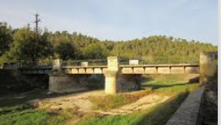
ROLE OF INTERMEDIATE LEVEL IN ENSURING STEWARDSHIP
In DRC: Efforts for HSS and reforms
Decentralisation
Intermediate level structures
(’Division provinciale’: administration;
‘Inspection provincial’ for control;
Provincial Ministry of Health for policy
In Lubumbashi: roles of intermediate level
Logistic support
Technical support
Social support
Motivational support

Slide 12
Profiles diversity of support to DHMT in Lubumbashi city
Logistic support
« … Il vient des partenaires, qui prenent ainsi les Equipes-cadres en otage…
… il est insuffisant, irrégulier, et moins structuré ou systématisé.
La DPS nous rassasie des promesses jamais réalisée
Le Médecin Chef s’accapare de tout apport logistique de la zone »
(FG-NISSEC 01)
Technical support
«.. Il est faible, voire inexistant.
La DPS assure des formations et supervisions de l’Equipe-Cadre pour les activités des partenaires et des programmes financés. L’encadreur provincial vient pour le coaching. Il n’ a pas des termes de référence pour ses visites »
(FG-NISSEC 02)
Lack of IHSL’s support
Social support
« L’ECD n’ont pas de statut juridiques. Les structures sanitaires privées résistent à nos instructions sur la qualité des services et des soins.
Les arrangements n’existent presque pas. Et même s’ils existent, c’est au profit du médecin chef de zone »
(FG-NISSEC 03).
Motivational support
« La DPS demande à ce qu’il y ait des réunions de l’équipe-cadre et avec les autres acteurs. Il n’y a pas de motivation pour ça. Il n’y a même pas des frais de fonctionnement ni prime de fonction des membres de l’équipe-cadre.
Les conditions de travail sont déplorables.»
(FG-NISSEC 04)

Slide 13
FINAL REFLECTIONS
Levers
Integrating small scale interventions + Fine-tuning it.
Optimizing self-organization
Inputs
Political,arrangements, laws, financing
Skills: selection, training, recognition
Coach, logistical, influence, regulation
Team building, monitoring, motivation
Vision and System
- Committement: PHC, DHS, Urban health
Political - intermediate HSL support to DHS
Managers, Teams, Professional, Players= DHS
Stewardship introduction and practices => HSS
Outcomes
Legitimacy and Trust
Well-being and Welfare
Change
Governance
Systems
Problems
Determinant
Urban devpt
Complexity
Fine-tuning
Small-scale
Selection
Solutions
Viewpoints
Process
DHMT in emerging change, action-research,…
Intersectoral and multilevel implication
Bodies networking + credible decision making,
Arrangements, domestic resources, financing
Outputs
Health coverage, Equity, satisfaction, protection
Community/poor participation, using
Coverage, Quality, relevance and efficience
Accountability and taking beyond health sector
Knowledge
Practice
Results
DHMT: interface position, HSS, Urban turn.
knowledge, care, agency, ethics…
Appreciate, advocate, counsel, train, regulate,
Identifie, inform, consult, imply, coproduce

Slide 14
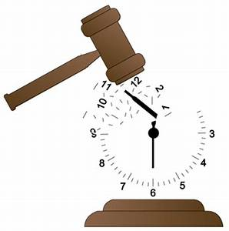
TO CONCLUDE
Major stewardship challenges in Lubumbashi’s health system
No coherent nor relevant regulatory tools and little support from the intermediate level to the DHMT
Need for stewardship building at DHMT and intermediate level
Preparing, HR selection, support and policy to enable adequate performance of the health system but also the stewardship function
But how to move to the next level:
Stewardship of the city

Slide 15
THANKS ! MERCI ! AKSANTI !

