Slide 1
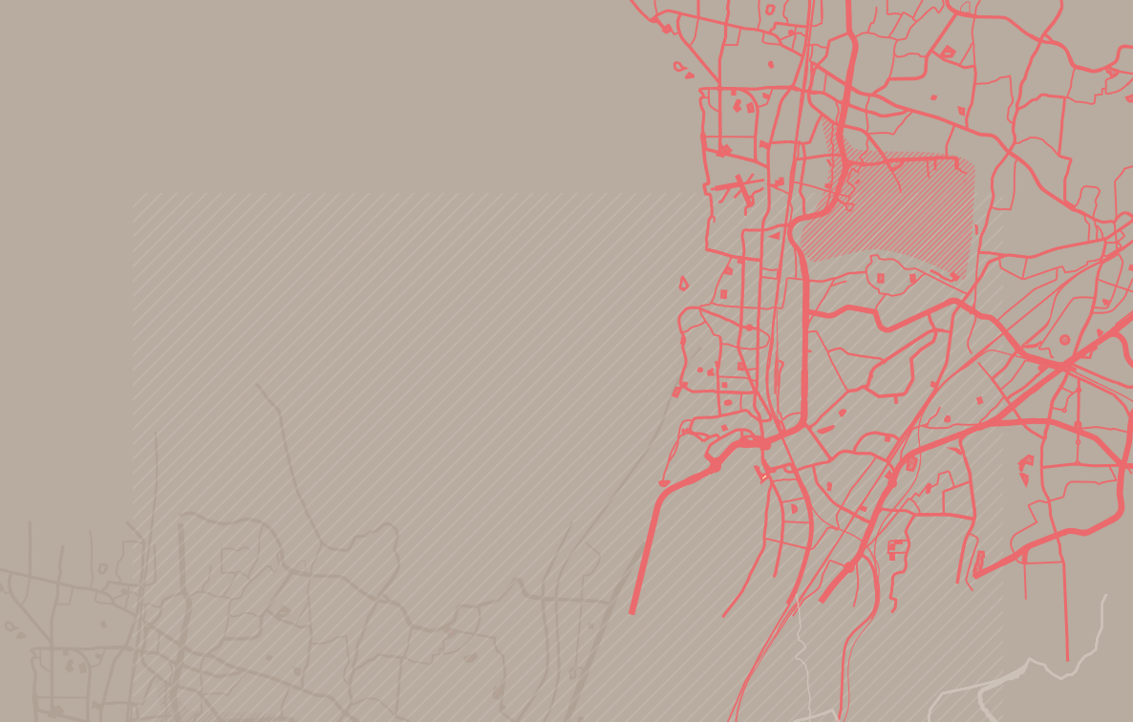
Cities: the road to success
in
Ending the AIDS Epidemic
Case study on Nairobi
Dr Jantine Jacobi
UNAIDS Representative to the EU
Jacobij@unaids.org

Slide 2
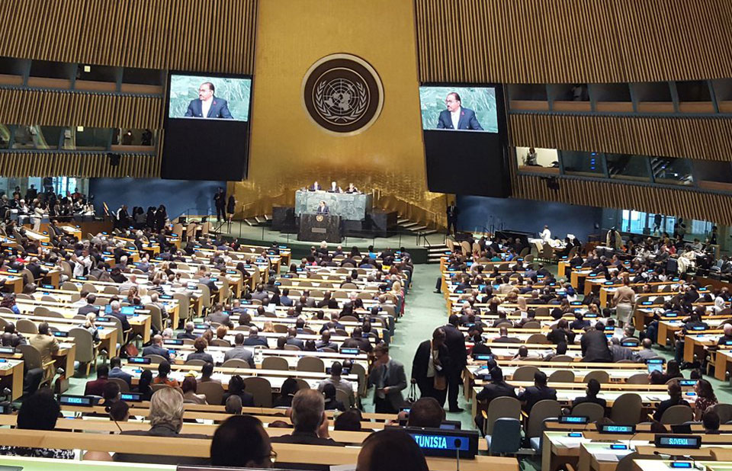
BACKGROUND: “UN POLITICAL DECLARATION ON ENDING AIDS AS A PUBLIC HEALTH THREAT BY 2030”
Calling on countries to fast track their comprehensive HIV response, while protecting the human rights and dignity of all people affected by HIV
As per UNAIDS Strategy with focus on subnational epidemics

Slide 3
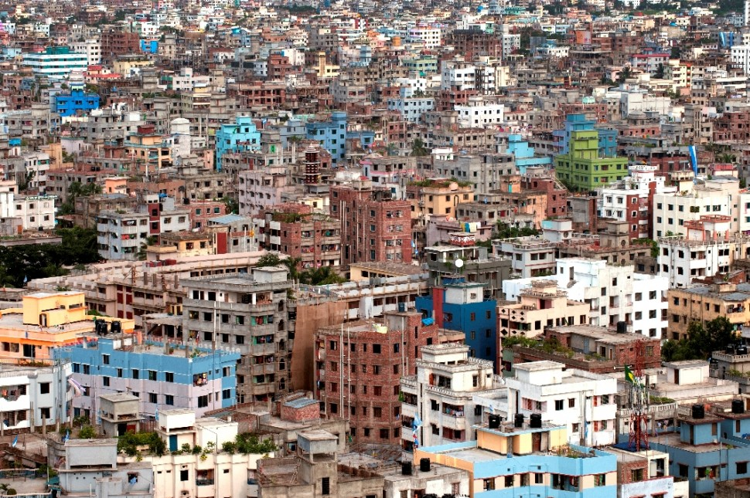
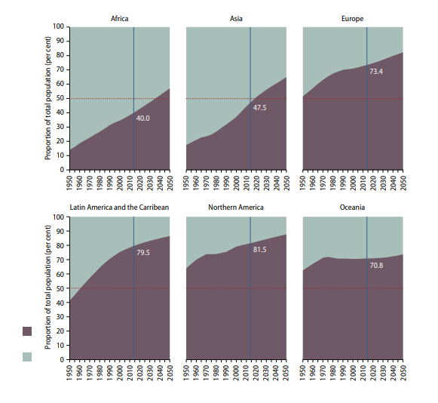
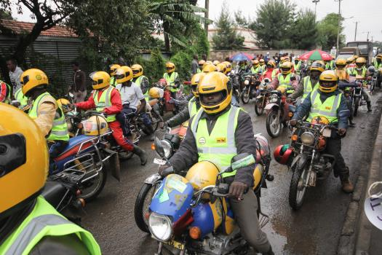
FAST TRACK AIDS IN CITIES: WHY FOCUS ON CITIES AND URBAN SPACES?
Increasing urbanization in
all regions
With social shifts and increased mobility

Slide 4
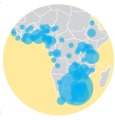
CITIES ARE AT THE CENTRE OF ENDING THE GLOBAL AIDS EPIDEMIC
200 cities around the world face 1/4 of global HIV disease burden
Transmission risk is often higher in urban areas
In sub-Saharan Africa, about 1/2 of all people living with HIV reside in urban areas, particularly young people and key populations

Slide 5
CITIES ARE WELL-PLACED FOR EFFECTIVE ACTION TO END AIDS
Characteristics of cities:
Powerful engines of economic growth
Regulatory powers
Excellence in learning, creativity and innovation
Better health systems and infrastructure
More social and political tolerance
Top 600 Cities represent >60% of global GDP
Source: United Nations, Department of Economic and Social Affairs, Population Division: World Urbanization Prospects, the 2009 Revision. New York 2010
5
Notes:
5
13/10/2019
5
5

Slide 6
PARIS DECLARATION AND COMMITMENTS 1 DECEMBER 2014
Key Commitments
End the AIDS epidemic in cities by 2030
Put people at the center of everything we do
Address the causes of risk, vulnerability, transmission
Use our AIDS response for positive social transformation
Build and accelerate an appropriate response to local needs

Slide 7
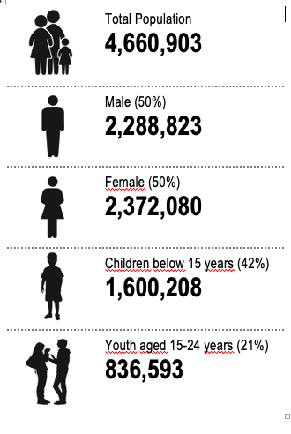
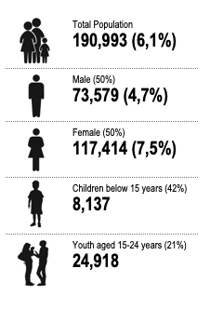
HIV BURDEN IN NAIROBI
Population Nairobi County, 2017
People Living with HIV, 2017
79–99–92
treatment target

Slide 8
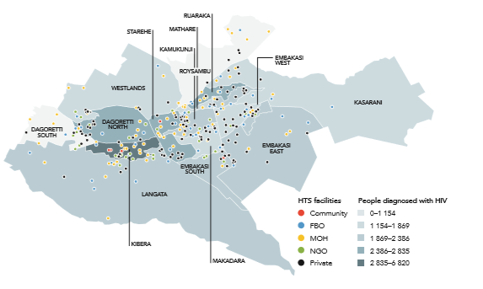
POPULATION/LOCATION FOCUS TO ANALYZE PROGRAMMATIC GAPS
7159 new HIV infections
46% among adolescents and young people
33% among key populations
mostly in 4 sub-counties
New HIV infections by subcounty, with overlay of health facilities, 2017

Slide 9
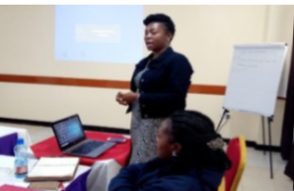
FACILITY-BASED QUALITATIVE ANALYSIS FOR TAILORED INTERVENTIONS
Determining informal settlements with high HIV burden among adolescents and young people (AYP) and key populations (KPs)
Qualitative analysis of service delivery for unmet HIV service needs and quality of services
Active engagement of AYP and KP
- in revision of national Adolescents Package of Care for health workers
- in training of health care workers

Slide 10
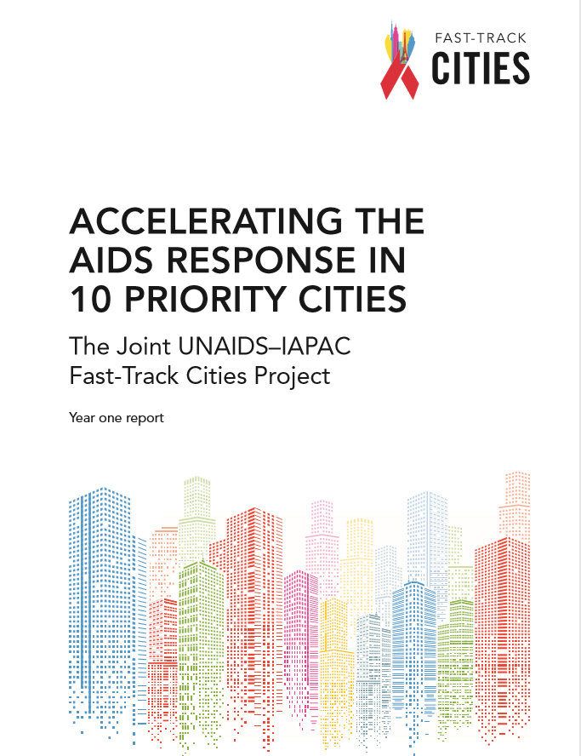
THANK YOU
http://www.unaids.org/en/cities

Slide 11
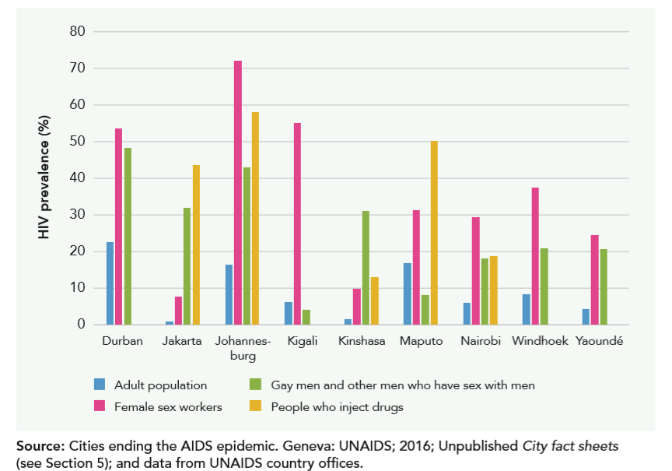
HIV prevalence in different populations in selected cities from year 1 of the project

Slide 12
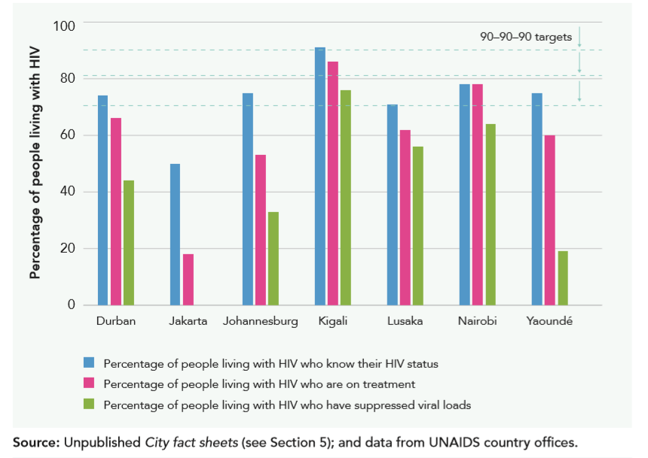
Treatment cascade relative to the number of people living with HIV for selected cities (baseline)

