Slide 1
ANNUAL INTERNATIONAL HEALTH CONFERENCE: « TAKING THE URBAN TURN »
Session D: One health in cities – linking health and its determinants in urban environments
15th and 16th october 2019
Citizen participation and social equity in a risk reduction intervention linked to air pollution in Abidjan, Cotonou, Dakar and Ouagadougou
Kêdoté Marius et al.

Slide 2
Plan
Context of the Air-sain project
Adoption of an approach focusing on citizen participation and equity
Main achievements
Challenges related to the process of citizen participation and equity

Slide 3
1. Context (1/5)
Source: European Environment Agency, 2013

Slide 4
1. Context (2/5)
Health consequences of AP (WHO, 2018)
Mortality: 1 million deaths annually in Africa among 7 million worldwide
Socio-economic consequences (Schraufnage et al., 2019; World Bank and IHME, 2016; Degila and Yves, 2011)
Lack of universal coverage → 12% of income spent on medication
Informal sector: low productivity and high absenteeism rates due to illness
Inequalities and vulnerability of certain groups (women, children, exposed professionals, etc.)

Slide 5
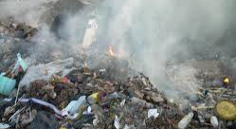
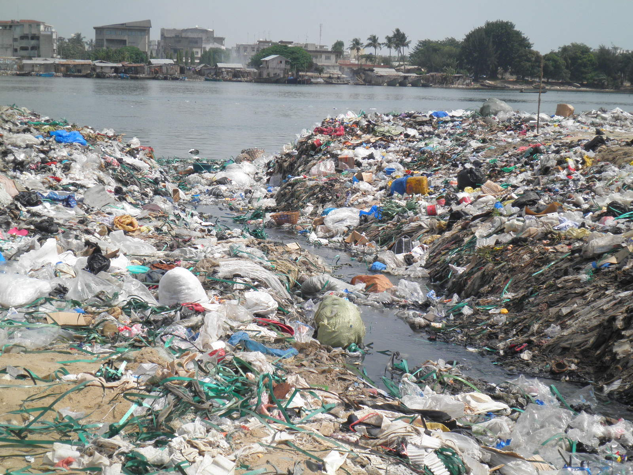
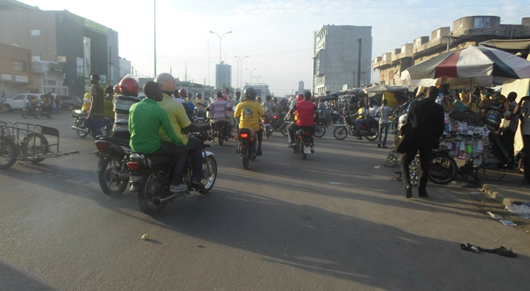
Benin
Notes:
Ces images ont montré l'iniquité des expositions à la pollution de l’air

Slide 6
1. Context (3/5)
Ecohealth Chair Project on Urban Air Pollution and its Impacts on NCDs (IDRC 2015-2020)
- OS 1 (research): Produce knowledge on urban AP levels and their impacts on NCDs in West AF
- OS 2 (Training): Strengthen researchers’ capacity on the issue of air pollution
- OS 3 (Action): Implement a participatory "AIR-SAIN" intervention aimed at changing practices through environmental education and the promotion of modern fuels
Notes:
The Ecohealth Chair is coordinated at the central pole level (Benin) and relies on contributions from members of NGOs and researchers from various disciplines in sub-Saharan Africa and elsewhere in the world (Belgium, Canada, France, Switzerland, United States, etc.).
Air-sain project of Social Responsibility of researchers (pursue long-term objective serving the good of society)

Slide 7
1. Context (4/5)
Geographical area of intervention

Slide 8
1. Context (5/5)
The Ecohealth Chair contributes to environmental health through dialogue between science and society dialogue
At the heart of the ecohealth approach is multidisciplinarity, participation and consideration of different types of knowledge (endogenous, scientific and practical)
- Endogenous practices contribute to the preservation of the environment (e. g. sacred forests, organic agriculture, pharmacopoeia...)

Slide 9
2. Citizen participation and equity(1/5)
Citizen participation = mobilize populations to make decisions, manage their resources and control the activities that have an impact on their lives
Partnership with community leaders: Neighborhood leaders, counselors, female leaders, etc.
- Collaborative workshop (understanding citizens' constraints and expectations)
- Co-design of awareness session
Broader community mobilization for the awareness-raising activity
Notes:
Collaborative workshop and preparatory meetings (understanding citizens' constraints and expectations)
Partnership with representatives of the most decentralized units of the State

Slide 10
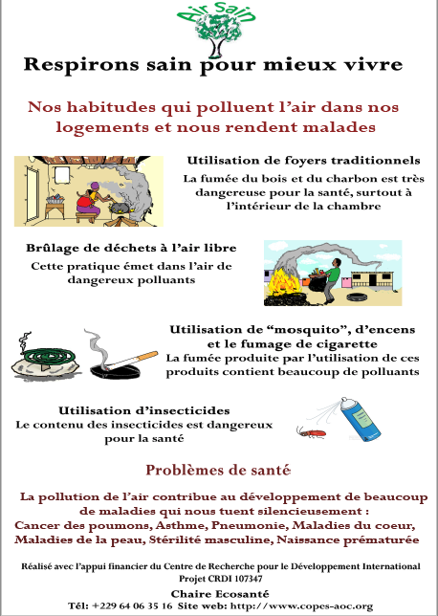
2. Citizen participation and equity (2/5)

Slide 11
2. Citizen participation and equity (3/5)
Practice of equity in the planning and implementation of awareness-raising activities
Selection of all socioeconomics groups
Meets the characteristics of equity
Posters collage in health centers, door-to-door awareness raising, flyers sharing and one-on-one discussions in local languages with households with low levels of education
- addresses the need for equality in access to education session (Pedrero, 1998)
Notes:
Indeed, according to the author, whatever the initiative or development mechanism, the beneficiary communities always participate, but the level of participation may vary.

Slide 12
2. Citizen participation and equity (4/5)
Distribution of improved traditional stoves
- To overcome the limits of awareness raising and to facilitate change in practice
Co-design of the recruitment strategy for stoves beneficiaries based on equity criteria (targeting the most socioeconomically disadvantaged groups)
Participation of government institutions, the Chair and beneficiaries in the purchase of stoves
Prioritization of vulnerable groups (pregnant women, wet nurse, the elderly) during distribution

Slide 13
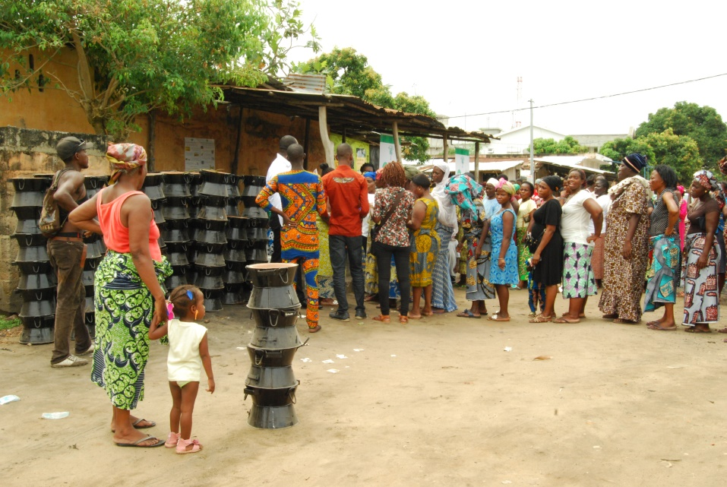
2. Citizen participation and equity (5/5)

Slide 14
3. Main achievements (1/2)
Strengthened knowledge of
- Sources of indoor air pollution (burning incense, waste and plastic bags, smoke, outdoor air, paints, etc.)
- health risks (respiratory NCDs, heart disease, male sterility, etc.)
Strengthened practices on
- fuels used, less burning of incense, waste, building ventilation, etc.
Notes:
(Respiratory NCDs including allergies and cancers, heart disease, male sterility, etc.)

Slide 15
3. Main achievements (2/2)
Other changes
Organization of awareness-raising sessions for men
Raising awareness in the neighborhood for better practices
Raising awareness among colleagues in the workplace for better practices
Conducting health-promoting campaigns

Slide 16
4. challenges of citizen participation and equity (1/2)
Persistent inequalities
It remains essential to invite community and religious leaders to awareness meetings (mostly men)
However, men tend to sit in front, speak more often and louder;
- they tend to stand up when they speak
What to do with misconceptions? Difficulties with the concepts of causality and risk?

Slide 17
4. Challenge of citizen participation and equity (2/2)
Difficult to define equity criteria for the distribution of improved traditional stoves
Initial strategy was to contact the Social Promotion Centers to determine the most disadvantaged households, but female leaders have changed the way participants are identified
It is a matter of dignity to identify the most disadvantaged

Slide 18
In conclusion
Air-Sain has helped to strengthen citizens' capacities for better improved urban health
- Participants open to learning
- Modified practices
- Community leaders are effective agents of dissemination
Despite some significant social impacts, local populations must be involved in the development and implementation of interventions that affect them

Slide 19
For more information
Yates, S., Saint-Charles, J., Kêdoté, M., Assogba, C. G. (2018). “Reducing air pollution in West Africa through participatory activities: Issues, challenges and conditions for citizens’ genuine engagement”. Handbook for Communication for Development and Social Change, J. Servaes (dir.), Springer.

Slide 20
THANKS

