Slide 1
Improving Health and Nutrition Status of Urban Extreme Poor
Service Delivery Component of “EU Support to Health and Nutrition to the poor in Urban Bangladesh”, MoLGRD&C
Wednesday, 16 October, 2019. Brussels, Belgium

Slide 2
Courtesy: UHSSP’2018

Slide 3
UNEQUAL

Slide 4
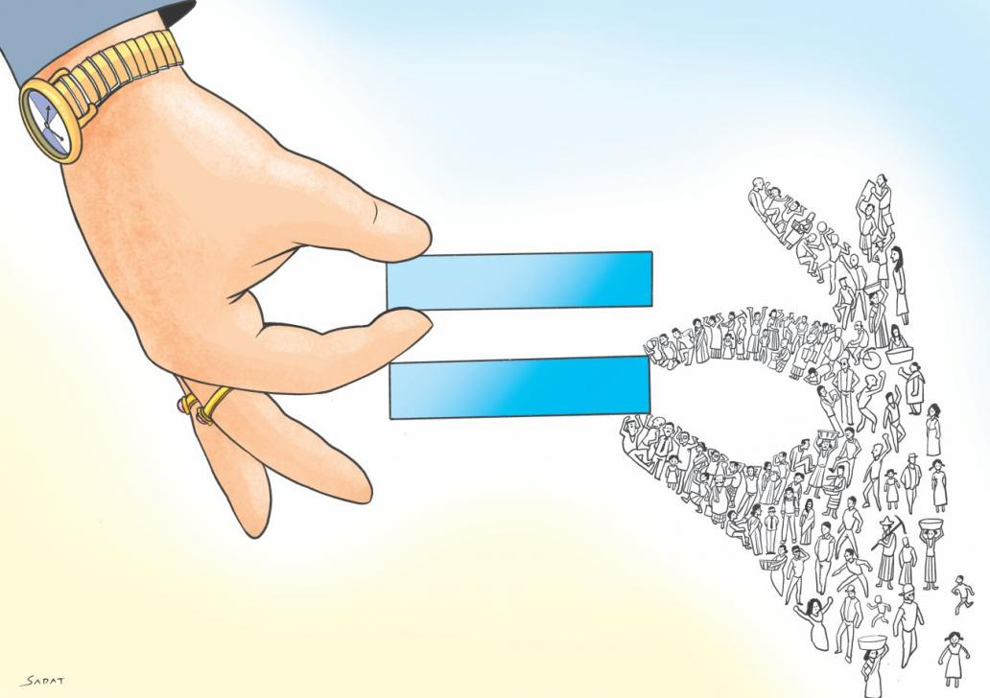
Inequality at all-time high in Bangladesh. 19, May 2019
Rich-poor gap way out of proportion; appears as a puzzle to fast-paced GDP growth
thedailystar.net

Slide 5
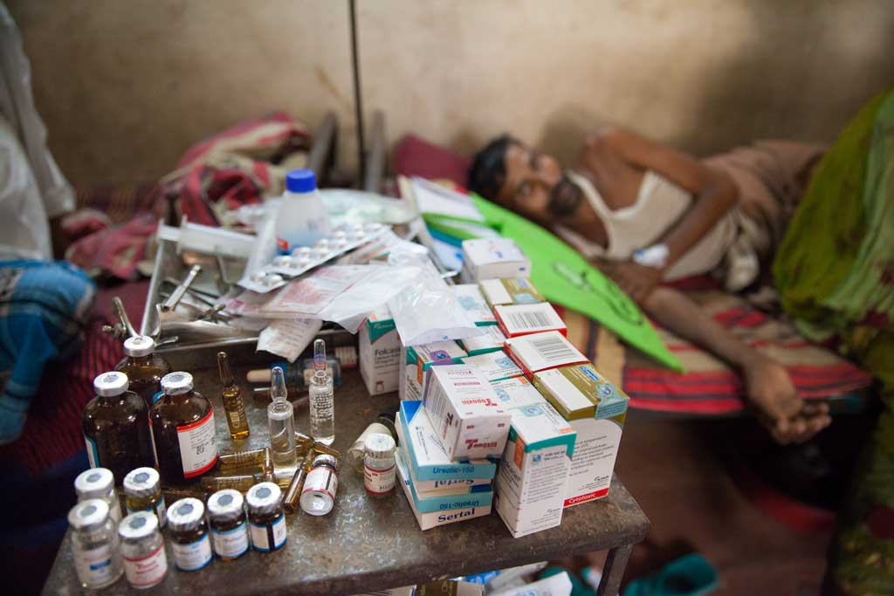
Catastrophic shocks!
64% out of pocket expenditure. Each year pushing the extreme poor into further poverty (NHA)

Slide 6
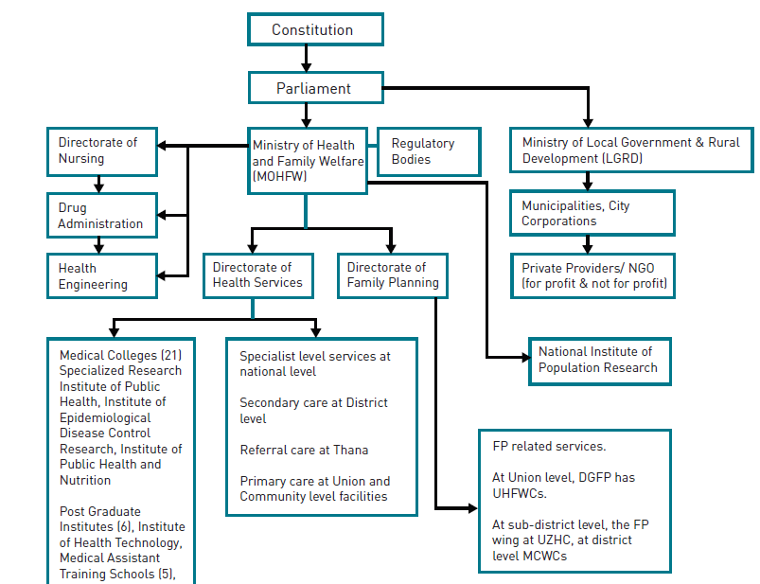
Urban
Organization
of the health
System in
Bangladesh
Rural

Slide 7
Socio Demographic
Operational
Dual burden of diseases
Increased burden of diseases associated with overcrowding, poor sanitation and hygiene
Administrative
Various administrative units with little coordination.
Multiple agencies/bodies providing health care
Lack of Standardization and standard treatment protocols
Lack of integrated HMIS and databases
Districts and zones not clear
Lack of grass root level structures
Diseases associated with air and water pollution
Diseases of nutrition
Inequitable distribution of health facilities
Lifestyle and stress related diseases, accidents/violence, substance abuse
Large segment of urban poor
In migration and floating populations
Diverse social and cultural backgrounds
Greater vulnerability of the migrating populations
KEY CHALLENGES OF URBAN HEALTH SERVICES
ILUEP
EU H&N

Slide 8
Concern Worldwide and BRAC Consortium
Euro 4.00 million value (Euro 3.00 million from EU +Euro 1.00 million Consortium contribution)
The Agreement was signed in end of Nov. 2016
Project duration: Until Nov. 2019
Implementing areas Dhaka City Corporation (North), Dhaka City Corporation (South), Chittagong City Corporation and Mymensingh Municipality.

Slide 9
Overall Objective
To improve the health and nutrition status of the urban poor through sustainable service provision, managed through a coordinated, national urban health delivery system.

Slide 10
Four Major Components
1: Increased availability, access to and utilisation of PHC, Nutrition and Population services by the Poorest
2: Improved comprehensiveness of existing PHC services by integrating nutrition, addressing service gaps and by increasing referral linkages
3: Enhanced quality coverage of PHC, nutrition and population services
4: Strengthened sustainability of urban health and nutrition services in partnership and coordination with Government, NGOs and community groups

Slide 11
ER 1: Increased availability, access to and utilisation of PHC, Nutrition and Population services by the Poorest
Major Activities:
Provision of free basic service package health, nutrition and population services at community and facility levels
Provide financial support to the extreme poor through voucher systems:
Voucher schemes will be introduced for those extreme poor who are not covered yet.
Extreme poor people will receive non cash financial support for accessing PHC services and emergency services.
Pilot one Micro health insurance scheme

Slide 12
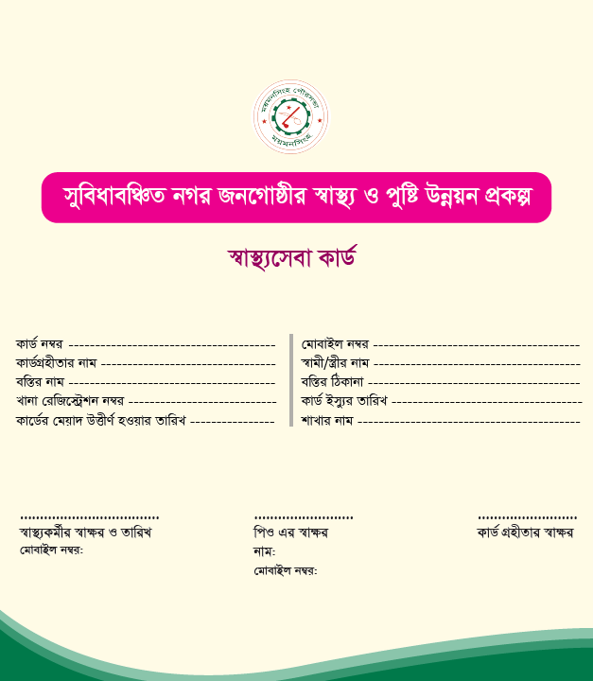
EU H&N project’s approach to respond to inequality
32,100 health voucher cards and 4,000 micro health insurance cards were distributed to ensure financial security for accessing Primary Health Care services. 91% + utilization
No cash transaction required
Increased quality PHC services with increased facility delivery to save life of mother and baby
Empowered extreme poor families
Reduced out of pocket expenditure for health care services
Encouraged elected representatives, as they are witnessing its direct impact. Mayor of CCC allocated budget to ensure sustainability, after end of project.
A sample health voucher card

Slide 13
A Health financing model for the extreme poor
Empowering women
Ensuring their rights
Reducing inequality
Better quality health services
Research ongoing on UHMIS & Measuring costs and effectiveness of health voucher & micro-health insurance schemes with icddr,b & LSTM – focus esp on sustainability

Slide 14
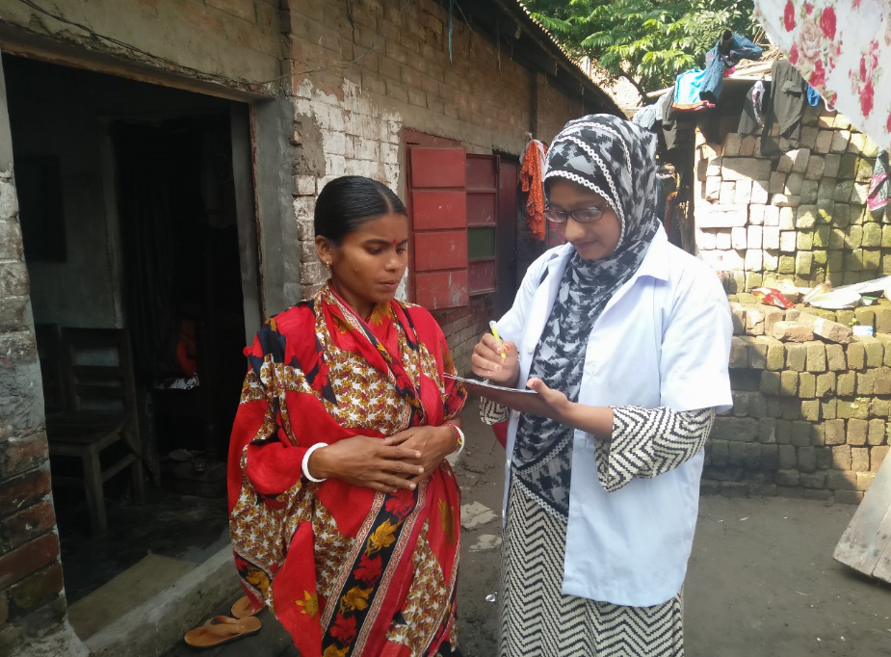
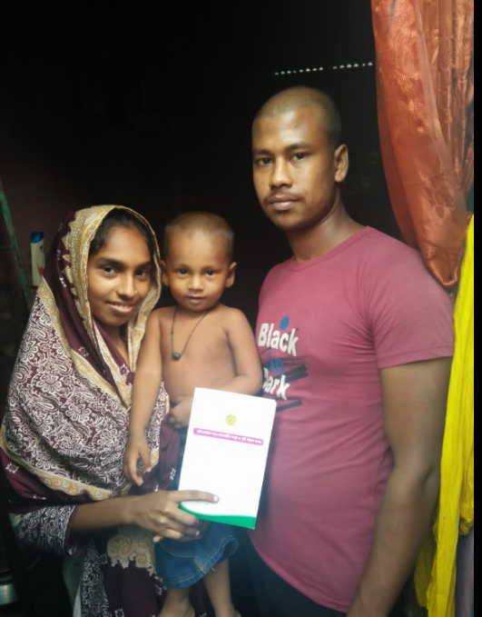
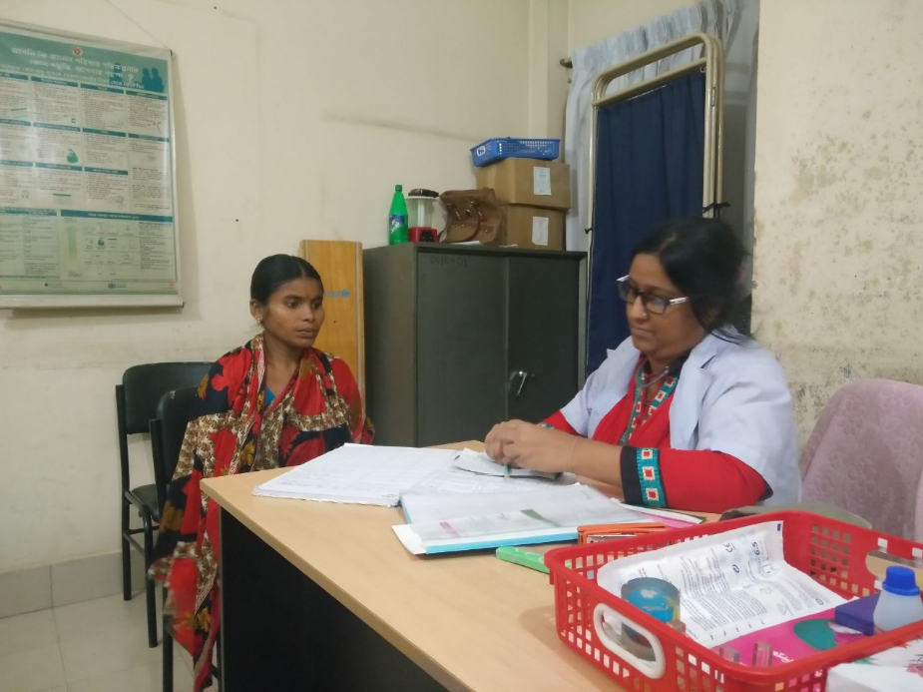

Slide 15
Building confidence towards a sustainable solution
Mayor and Councilors are closely watching/monitoring health services utilization by the extreme poor
Ward Health Committees and other coordination platforms are enabling them to oversight activities and to receive feedback
Accountability, quality of services from health services providers and city corporation ends are being ensured
Governance and Accountability strengthened
Sustaining the system (e.g. health voucher, micro health insurance)
Chattogram City Corporation has allocated a budget of 215,835.05 Euro for one year to cover more extreme poor household families

Slide 16
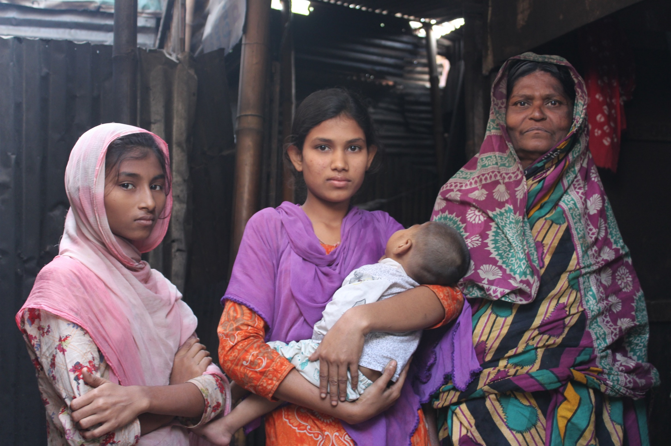
A more equitable health care system for all population

Slide 17
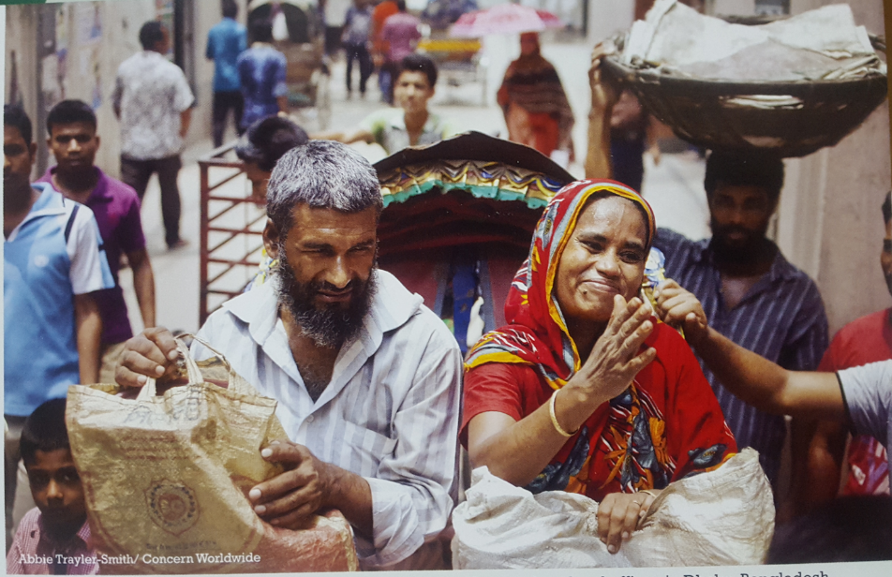
s
Leave no one behind!

