Slide 1
The complexity of governance of health services in cities The example of Ouagadougou
Noël Nacoulma

Slide 2
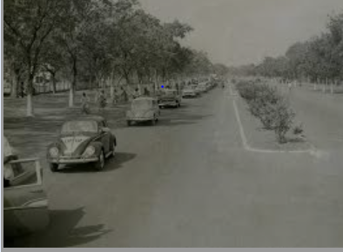
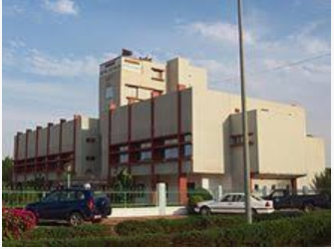
Ouagadougou in 2016
Ouagadougou in 1960
Source : https://fr.wikipedia.org/wiki/Ouagadougou

Slide 3
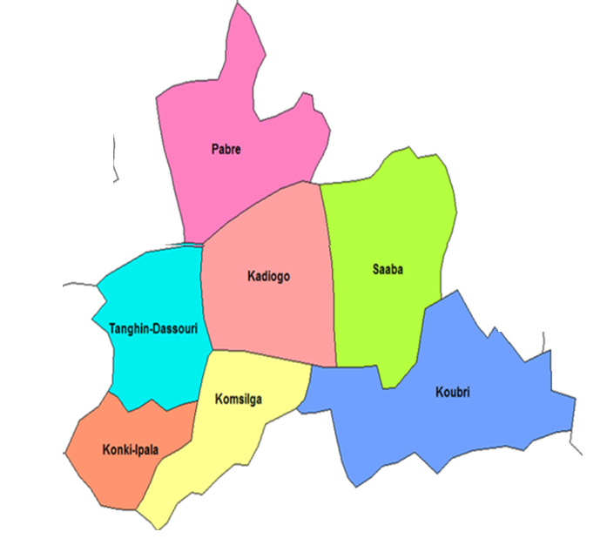
The city of Ouagadougou
An expanding city
1960 : 59.000 inhabitants
2018 : + 2.000.000 inhabitants
2050 : +43% growth
Urban population has doubled in 30 years
Geographically flat area, housing spread out
”Each his own plot"
Emergence of new neighborhoods (all languages)
Re-zoning of city in sectors
But health sector = not co-evolving
1 urban municipality : Ouaga + 12 ‘arrondissements’
6 rural municipalities

Slide 4
Organisation of the health system in Ouagadougou
District Health System
Five districts:
3 rural districts with a ‘centre médicale avec antenne chirurgical’
2 urban districts centered on university hospitals
1994 - 2004: little change
District health management team’s responsibilities
District is the operational unit of the health system
Implementation of Ministry of Health policies and programmes
Planning:
standardised top down approach
targeted interventions by donor-funded programmes
Governance of public sector actors
private sector?, traditional sector?

Slide 5
Governance of health sector
Ministry of Health
Regional Directorate of Health
District Health Management Team
150 private providers
Municipalities
11 community-based organisations
37 nurses-in-charge
37 health Management Committees
22 heads of service
350 community health workers

Slide 6
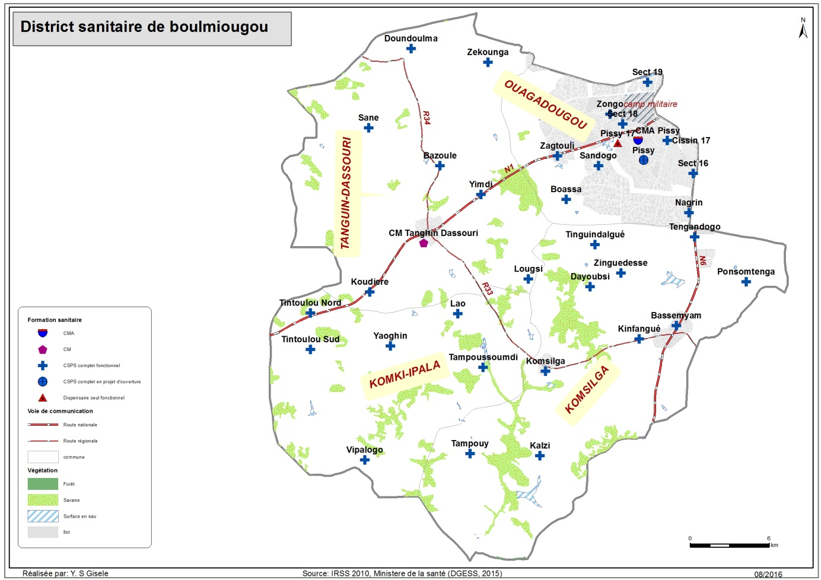
The district of Boulmiougou
Urban zone
2016: 811 hbts/km²
2018: 951 hbts/km²
13 ‘secteurs'
+10 non-planned zones
Population : + 1.000.000
Public health facilities: 38
Private health facilities : + 150
Rural zone
3 municipalities
Population: X 2
Creation of new villages (administrative et political units)

Slide 7
Organisation of the health system in Boulmiougou
Rural zone
25 public health centres
Community healthcare package
No district-level hospital
Referral to district-level hospital in urban zone and university hospitals
Urban zone
11 health centres
CSPS Sandogo: 56.000 inhabitants
CM Nagrin: 135.000 inhabitants
CSPS Secteur 28: 150.000 inhabitants
Large number of staff in these HC
One district-level hospital
Easy connections to university hospitals

Slide 8
Organisation of the health system in Boulmiougou
Private sector
Private for profit and non for profit
Hospitals, clinics, dispensaries, maternities, pharmacies (150)
Branchjng out from main road arteries to peripheral areas
Municipality of Ouagadougou
Hygiene and sanitation service
Fire brigade
International airport of Ouagadougou
Private ambulance services
Informal heath sector
Traditional health sector
Mainly in rural and peri-urban zones

Slide 9
Governance structure in Boulmiougou district
District Health Management Team
9 members
= administrative entity
Weak competences, weak financial capacity
Weak planification
Rural zone
Health facilities run by Nurse-in-charge and Community Health Committees
Municipalities have decentralised authority, but weak budgets

Slide 10
The challenges
Emerging health problems
Cardiovascular diseases, cancer, chronic kidney disease, drug abuse
Homosexuality (MSM), mental health (stress)
Taking care of the poor: social action
Adolescent / youth health
School health, reproductive health (incl. FP)
Challenge of taking care for ignored/ excluded groups
How to ensure that their health problems are taken care of (social connections)
Teenage pregnancy, FP, Abortion, care for MSM, HIV

Slide 11
The challenges
Health service organisation
Health workforce: typical urban concentration of staff
51 health workers at CM Nagrin
Referral chain not respected (CSPS-CMA-CHU)
Policy implementation gaps
Example: fee exemption policy
Poorly adapted to urban realities

Slide 12
The challenges
Lack of collaboration with other actors
Region and province: conflicts of interest
Exemple : organisation of emergency response (ex. ebola)
Governance
Multiple actors: Ministries, municipalities, politicians, CBO, NGOs, etc
Divergent adminstrative/political and operational district boundaries

Slide 13
The challenges
Demands from health professionals
Professional associations and unions of all cadres
Rising expectations of the population
Insurrection in 2014
Corruption
Media : the role of popular talk show on the radio
Civil society organisations: Advocacy/mobilisation by NGOs and women/youth/other groups
Health became a political issue

Slide 14
The challenges
Climate change
Floods
Affecting the University Hospital Yalgado in 2009
Heatwaves due to deforestation
Pollution
Security
Terrorism
Consequences
Weakening of the health system
Seeking care abroad (cost/inequity)
Tensions between health service users and providers

Slide 15
Priorities
Improve health service / system management
Redefine tasks and task distribution to improve skill mix
Improve salaries of health workers
Improve care and supply systems (incl. essential drug supply) through digitalisation
Reorganisation of the health system
Re-organisation of the districts
Rural and urban zones
Referral chains
Re-organisation of emergency response
CHUB
CHU-YO
CHU-T
CMA

Slide 16
Priorities
Improve governance
Deal with the private sector
Review task distribution between district/region/municipalities

Slide 17
Way forward
Dealing with climate change
Need for city-wide integrated governance systems
Find common themes for sectors to collaborate
Need for stewardship function

