Slide 1
Mothers At Risk Innovating to improve urban maternal health
Rachel Hammonds
Be-cause Health Conference
Brussels, October 16, 2019

Slide 2
Scoping study - Why urban?
Half of humanity – 3.5 billion people – lives in cities today and 5 billion people are projected to live in cities by 2030.
95 per cent of urban expansion in the next decades will take place in the developing world.
883 million people live in slums today and most them are found in Eastern and South-Eastern Asia.
Urbanization is exacerbating existing stressors on health systems, potentially undermining the urban health advantage.

Slide 3
The impact of rapid urbanization?
Notes:
Pressure on - fresh water supplies, sewage, the living environment and public health

Slide 5
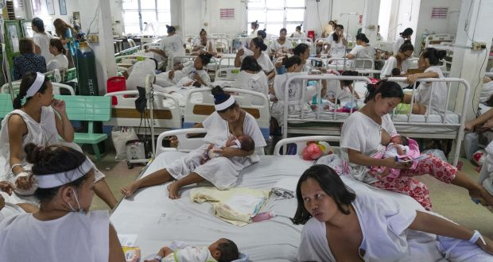
Scoping study - urban maternal health

Slide 6
Scoping study - urban maternal health
Urbanization is exacerbating existing stressors on health systems, potentially undermining the urban health advantage.
Increasing urbanization will change:
social norms,
life patterns, and
expectations of and demands for maternal health services.

Slide 7
Multiple challenges/opportunities
Dearth of research “Research is urgently needed on how best to care for poor women in urban areas” (Lancet 2015)
Difficult to predict how demography will impact on demand and create new demands (rich/poor gap)
Increasing attention from national governments and international community
Potential for information and communications technology

Slide 8
Knowledge gaps
need for knowledge generation on health service delivery and utilization in urban spaces, particularly among the urban poor.
need for research, design and evaluation of urban maternal health services that span the continuum from antenatal to postnatal care.
Knowledge generation, research, design and evaluation all need women’s participation.

Slide 9
Programming gaps
Most vulnerable segments of slum communities not reached by programmes
Lack of projects addressing the specific needs of urban poor adolescent girls
Lack of projects addressing maternal mental health in poor urban environments
Few urban maternal health programmes take advantage of mobile technology in service delivery

Slide 10
Three Delays Model – Thaddeus and Maine 1994
Delay
First | Delay in deciding to seek care on the part of the individual, family or both.
Second | Delay in identifying and reaching a health facility with quality, appropriate services.
Third | Delay in receiving quality, appropriate care.

Slide 11
Information and communication technologies to improve maternal health
The potential for information and communication technologies (ICT) to improve maternal health by enhancing decision-making among and by women, healthcare providers and policymakers.

Slide 12
MAR – Maternal Uber
-Vodafone Foundation launches the Emergency Transportation System in July 2015 in rural Tanzania
-Population Services International launches a boda boda service to get pregnant mothers to antenatal appointments in Kampala, Uganda 2016

Slide 13
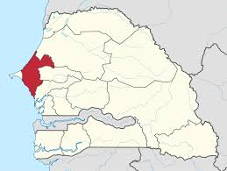
Senegal - Yeebal Project (transfer Wolof)
Justification: Access to timely care remains inadequate, even in urban centers, as financial barriers and lack of suitable transport options for women in need remain high.
Pilot in the Thiès region
over 66,000 births year
67.6% of deliveries in
facilities with no basic Emergency Obstetric Care

Slide 14
Objectives
Improve access to health facilities for pregnant women using a new mHealth mobile application to streamline transportation to health care facilities.
Sub-objectives/approach:
strengthen urban transfer systems /through improved coordination and cashless payment methods for women in need of obstetric care.
provide women with relevant pregnancy related tips and information/throughout their pregnancies
Increase engagement with maternal health by training taxi drivers to play a role in transporting pregnant women to a facility in a timely manner.

Slide 15
Key beneficiaries/stakeholders
Primary beneficiaries: Poor peri-urban women who are, or are planning to be, pregnant.
Secondary beneficiaries: Taxi drivers in the region of Thiès.
Primary stakeholders: Ministry of Health and Health facilities in the region of Thiès.
Secondary stakeholders: Mhealth provider and local implementer

Slide 16
Lisungi – Mobile Clinic in Kinshasa, DRC

Slide 17
Thank you

Slide 18
Expected Outputs | Indicators | Verification
Pregnant women will have access to Yeebal platform | 300 women enrolled 150 women actively use Yeebal | Number of women enrolled on monthly basis as verified by bi-monthly data exports
A pool of transporters will be available to women enrolled | 10 drivers contracted | Number of drivers enrolled, trained and connected to network verified byregular bi-weekly meetings
Requests made in app will result in transport of women | 100% requests will result in vehicles dispatched | Number of requests made resulting in dispatched transportation as verified by bi-monthly data exports
Demand generated for service in future | +90% client satisfaction from women + 90% of transporters satisfied with Yeebal partnership | Interviews with transporters and text follow up messages with women enrolled
Knowledge of healthy behavior | Weekly health/pregnancy texts to women enrolled 80% messages read 80% of women understand importance and timing of ANC visits and facility-based care | Bi-monthly data exports

Slide 19
District of Thiès, Senegal
Thiès has over 66,000 births annually with 67.6% of deliveries occurring outside facilities with basic Emergency Obstetric Care
poverty rate of 70.3% (Dakar 46.5%) and
HDI of 0.3 compared to the national average 0.47.
Thiès district, 6601 km has 3 hospitals, one is 25km from the capital city of the region, Thiès’ main hospital, and one is 66km away.
It has 155 health posts and 341 health huts.

